Slide 1
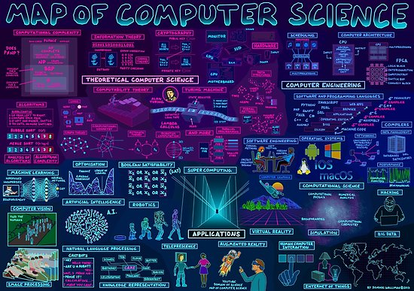
PROGRAMMING WITH PYTHON
Okan Ciftci
Ugurcan Kok

Slide 2
SYLLABUS
Theoretical
Variables,Algorithms,Arithmetic Operations
If/Elif/Else,Practices
Loops,Practices
Data Structures,Practices
Functions,Practices
Object Oriented Programming,Practices
GUI,Practices
Complex Practices

Slide 3
Questıons
What is a computer ?
What is a software ?
What is a programming language ?
What is a computer program ?
What is a python ?

Slide 4
hıstory
Charles Babbage / Ada Lovelace
Alan Turing
ENIAC
Von Neumann Architecture

Slide 5
pROGRAMMING LANGUAGES
Programming Paradigms
Programming History
Programming on Desktop/Web/Mobile/AI
Low/Medium/High level languages
More languages More Advantage ?
IDE
EDITOR

Slide 6
COMPILER & INTERPRETER

Slide 7
Compiler:A compiler is a software program that transforms high-level source code that is written by a developer in a high- level programming language into a low level object code (binary code) in machine language, which can be understood by the processor.
Interpreter:An interpreter is a computer program that is used to directly execute program instructions written using one of the many high-level programming languages.The interpreter transforms the high-level program into an intermediate language that it then executes, or it could parse the high-level source code and then performs the commands directly, which is done line by line or statement by statement.

Slide 8
Dıfferences
Interpreter
Translates program one statement at a time.
It takes less amount of time to analyze the source code but the overall execution time is slower.
Programming language like Python, Ruby use interpreters.
Compiler
Scans the entire program and translates it as a whole into machine code.
It takes large amount of time to analyze the source code but the overall execution time is comparatively faster.
Programming language like C, C++ use compilers.

Slide 9
Python programmıng language
High-Level programming language
Open Source
Easy to create GUI/Web/AI applications
Easy to find resources
Easy to learn for beginners

Slide 10
Ide
Anaconda
https://www.youtube.com/watch?v=T8wK5loXkXg
https://www.udemy.com/complete-python-bootcamp/
Python Setup Content Second Video
Jupyter Notebook,Pycharm,Spyder,Online Interpreter ?

Slide 11
Resources
You can find all source code, materials, helper links, community film and book recommendations on github
https://github.com/okanvk/2018-2019-ADU-IEEE-CS-Python-Course

Slide 12
References
https://www.programiz.com/article/difference-compiler- interpreter
https://www.techopedia.com/definition/7793/interpreter
https://www.techopedia.com/definition/3912/compiler

